Slide 1
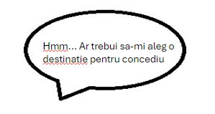


Slide 2
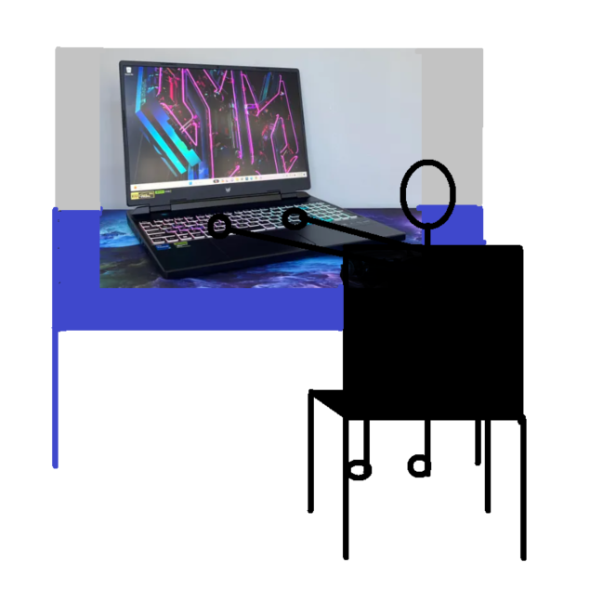
Story board interfata Web
Image from: https://www.cnet.com/tech/computing/best-laptop/

Slide 3
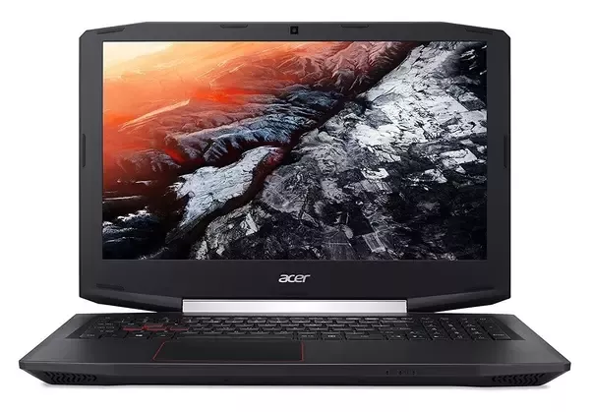
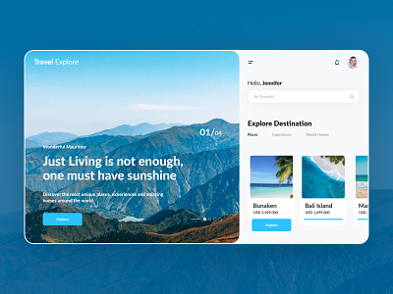
User ul cauta oferte prin introducerea cuvintelor cheie sau alege din categoriile existente.
Photo laptop: https://salecinask.live/product_details/49201677.html

Slide 4
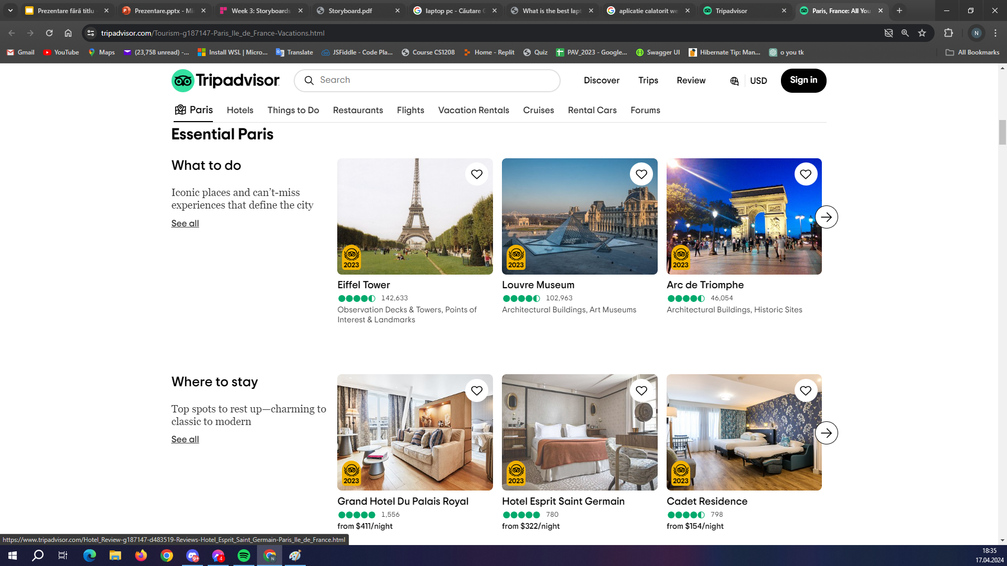
Dupa introducerea cuvintelor cheie, user ului ii sunt aratate sugestii din care poate alege.
Photo source:
https://www.tripadvisor.com/Tourism-g187147-Paris_Ile_de_France-Vacations.html

Slide 5
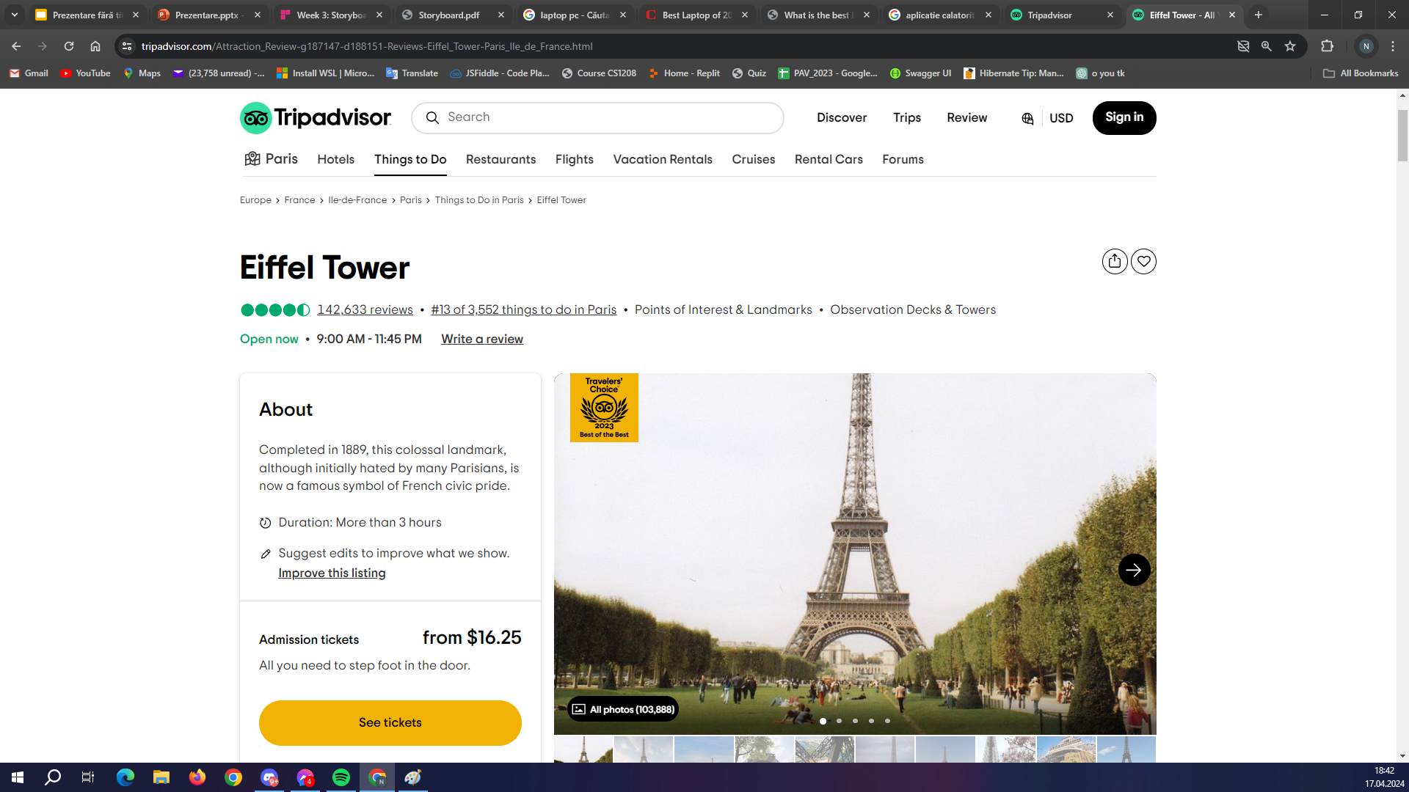
User ul poate interactiona cu sugestiile, poate cumpara bilete, rezerva camere de hotel sau doar verifica valabilitatea ofertelor.
Photo source:
https://www.tripadvisor.com/Attraction_Review-g187147-d188151-Reviews-Eiffel_Tower-Paris_Ile_de_France.html

